Slide 1


BIE ELA & Math
Spring 2026 Assessment
Pre-Administration Training
In-person: January 7, 2026
Virtual Session 1: January 22 & 23, 2026
Virtual Session 2: January 29 & 30, 2026

Slide 2
Welcome & Purpose
Welcome from the Chief Academic Office and ELA/Math Assessment Team, Aurelia Shorty, Donald Griffin, Dr. Carmelia Becenti, Dr. Rebecca Izzo, Dr. Clauschee & Dr. BJ Howerton.
The purpose of these trainings is to:
Provide implementation assistance to schools for BIE’s Summative ELA and Math assessments for SY 2025-2026.
Provide a set of expectations for assessment tasks and activities before, during, and after testing.
To assist school staff, virtual trainings will be recorded for your viewing convenience.

Slide 3
Agenda
1
Key Administration Dates
4
Before Testing
2
Test Structure & Guidelines
5
During Testing
3
Accommodations & Accessibility Features
6
After Testing

Slide 4
Key Administration Dates

Slide 5
Key Administration Dates – Pre-Admin
February 4
March 9
Deadline to update & verify Student accommodations in ADAM & to confirm school address in LaunchPad.
This ensures tests are assigned correctly and paper shipments/preID labels are created for Paper testers.
Initial shipment of test materials scheduled to arrive in schools

Slide 6
Key Administration Dates – Admin
March 9 – May 1
March 23 – May 1
Additional Orders Window
Braille Test Kits
Human Reader Test Kits
Large Print Kits
Regular Paper tests
Shipping Labels
Math tools
Reference Sheets
Test Administration Window

Slide 7
Key Administration Dates – Post-Admin
May 4
May 8
May 15
Deadline to return non-scorable secure testing materials to Pearson
Deadline to return scorable Paper testing materials to Pearson
Deadline to manually submit all tests & apply accountability codes in ADAM;
Deadline to resolve rejected test alerts in ADAM

Slide 8
Test Structure & Guidelines

Slide 9
BIE Guidelines
Paper-based tests (PBT) versus computer-based tests (CBT):
  The BIE will not order PBT for schools that have been identified to use the CBT. The BIE encourages schools use CBT if they have the technical capability to do so.
  Exception would be for students needing paper as an accommodation for IEP or 504. Contact the BIE if you have further questions.
Participation – All students in grades 3-8 and 11 will take the Spring ELA and Math Assessment per ESSA.
No remote testing – If students are learning remotely and a school cannot test students securely, contact BIE for guidance. Paper-based tests cannot be sent home.

Slide 10
Test Structure & Guidelines
Test Administration Window
Tests Administered
Computer-based and Paper-based Testing
March 23 – May 1, 2026
English Language Arts
Mathematics
Grades 3-8
Grade 11
Grades 3-8
Algebra II (Grade 11 students)

Slide 11
Test Structure & Guidelines
On-grade level testing only
3-8 Math/ELA students are only allowed to take the test for their grade level (i.e., 3rd graders can take Grade 3 Math and Grade 3 ELA).
Grade 11 students take Grade 11 ELA and Algebra II.
NOTE: Algebra I, Geometry, and Integrated Math I, II, & III are no longer tested.

Slide 12
Test Structure & Guidelines - ELA
Grade(s)​ | Content Area/Course​ | Number of Units​ | Time​ | Total Time​
3​ | ELA | 2 | Unit 1: 75 minutes Unit 2: 90 minutes | 165 minutes​
4-8​ | ELA | 2 | Unit 1: 75 minutes Unit 2: 90 minutes ​​ | 165 minutes​
11 | ELA | 2 | Unit 1: 75 minutes Unit 2: 90 minutes ​​​ | 165 minutes​

Slide 13
Test Structure & Guidelines – Math
Grade(s)​ | Content Area/Course​ | Number of Units​ | Calculator | Unit Time​ | Total Time​
3-5 | Mathematics | 3 | No calculator | 45 minutes | 135 minutes
6-7 | Mathematics | 3 | Unit 1 - Non-calc & Calc section Unit 2 & 3 - Calc | 45 minutes​​ | 135 minutes
8 | Mathematics | 3 | Unit 1 – Non-calc Unit 2 & 3 - Calc | 45 minutes | 135 minutes
11 | Algebra II | 2 | Unit 1 - Non-calc & Calc section Unit 2 - Calc | 70 minutes | 140 minutes

Slide 14
Scheduling Considerations
Computer-based testing
For security purposes, each unit (e.g., Unit 1, Unit 2, Unit 3) should be scheduled as ​close together as possible for all students within the same grade/course, with​ the exception of make-up testing.
Test units must be administered in consecutive order.
Schedule the first CBT group on the first day with a little more time than other groups if possible.

Slide 15
Scheduling Considerations
Paper-based testing
For security purposes, each unit MUST be completed by all students for the same grade/course on the same school day, except for make-up testing or students with an extended time accommodation. ​
  For example, all students enrolled in Algebra II should complete Algebra II, Unit 1 on the same day. This may require scheduling more than one testing block for each unit on a given day.
Test units must be administered in consecutive order.
Schools must have the grade level appropriate calculator (grades 6-8 & 11) if administering math on paper.

Slide 16
Scheduling Considerations
Determine whether one content area will be completed before beginning the next, or if testing will alternate between the content areas (excluding make-up testing).
Determine whether the school wants to condense testing (excluding make-up testing) or spread throughout the testing window.
Determine how many units will be taken by students per day (excluding make-up testing).
If the unit testing times and directions are the same, different tests can be administered in the same room.
  i.e., Math grades 6 and 7 can be administered in the same room.
  ELA/Math cannot be administered in the same room because the directions are different.
  Ensure that all calculator/non-calculator sections are the same (e.g., Grade 6 & 7).
CBT and PBT CANNOT be administered in the same environment.
Do not start a unit unless there is sufficient time left in the day to complete the unit.
Testing times are Monday – Friday during regular school hours.

Slide 17
Guidelines for Administration Time
Guidelines for Scheduling | Task | Time
 | Pre-administration tasks, including reading instructions to students and answering questions​ | 10 minutes​ (recommended)​
 | Distribution of test materials to students​ | 5 minutes​ (recommended)​
 | Administration of unit​ | Refer to Unit Testing Times (45-90 minutes)​
 | End-of-unit activities, including logging students out of TestNav and collecting test materials​ | 5 - 15 minutes​ (recommended)​

Slide 18
Guidelines for Administration Time
Schedule the entire amount of Unit Testing Time.
Once the Unit Testing Time has elapsed, that unit must end.
If all students have completed the unit, the unit may be ended early (no minimum testing time).
Plan a couple of extra days during the window for bad weather days and makeup testing.

Slide 19
Guidelines for Breaks
Between units, scheduled breaks may occur.
During a unit, short “stand-and-stretch” breaks may be permitted at the discretion of the Test Administrator.
  Time stops for the unit, but only for a maximum of 3 minutes.
  If you know you will take the 3-minute break, this should be added to the timing box at the beginning of the unit.
9:00 a.m. – 9:45 a.m.​ | Unit 1
9:45 a.m. – 10:00 a.m. | Scheduled Break
10:00 a.m. – 12:00 p.m. | Unit 2

Slide 20
ELA Reference Sheets
ELA now has Writing Reference Sheets for the Extended Constructed Response (ECR) items. The Writing Reference Sheets can be found on the BIE support site under Summative Resources/Additional Resources/Writing Reference Sheets. ​They will also be available as exhibits in online ELA tests, and they will be shipped for Paper testers.
There is a different sheet for each type of writing: ​
Argumentative ​
Informative​
Narrative​
Opinion
NOTE: Students will only have two of the four writing types during summative testing.

Slide 21
Accommodations & Accessibility Features

Slide 22
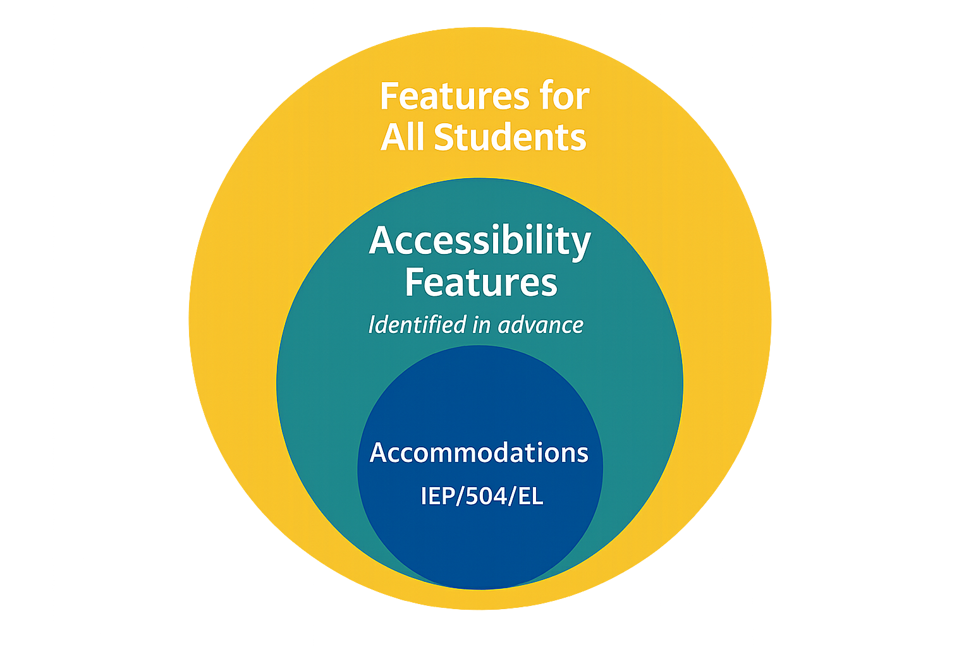
Accommodations & Accessibility Features
Features for all students
TestNav tools available to all students
Administration considerations
Testing environment
Accessibility features
Answer mask / color contrast
Accommodations
Requires IEP/504 or EL plan
  Test Coordinators will need to confirm that the correct accommodations have been added to the students' records by viewing the student details in ADAM and update as needed.

Slide 23
Accommodations & Accessibility Features
CBT Accessibility feature examples (TestNav)
These are available or should be made available to all students. They do not need to be assigned in ADAM prior to testing:
Line Reader
Answer Eliminator
Magnifier
Highlighter
Bookmark
Pop-up glossary
Notepad
Blank Scratch Paper
  After testing Test Administrators are responsible for collecting ALL scratch paper after testing has completed to be securely destroyed.

Slide 24
Accommodations & Accessibility Features
Administration considerations examples
These should be identified and noted for the Test Administrator in advance of testing:
Adaptive and Specialized Equipment or Furniture​
Frequent Breaks​
Small Group Testing​
Specified Area or Setting​
Separate or Alternate Location​
Time of Day​
NOTE: These do NOT need to be captured on the student record in ADAM.

Slide 25
Accommodations & Accessibility Features
Accommodation form specific examples**
Computer-based:
Human Reader
Dynamic Text to Speech
Paper-based:
Braille​
Large Print
Paper
*Students cannot have multiple form specific accommodations.
*Accommodations MUST be updated on the student record in ADAM and require an IEP/504 or EL plan.

Slide 26
Accommodations
Differences between Text-to-Speech & Human Reader / Read Aloud
Dynamic Text to Speech – Computer reads the content via the TTS functionality. Text with graphics is included for math as needed. This is not for blind or low-vision students.
Human Reader / Read Aloud – Assessment is read aloud by test administrator (student can test either CBT or PBT). Units/sections match Paper test.
  Math and ELA require a 504 or IEP for the Human Reader/ Read Aloud accommodation, and the provided paper test book must be used as a script.

Slide 27
Accommodations for English Learners (ELs)
Extended Time
Word-to-Word Dictionary (English/Native Language)
Mathematics Response Speech to Text
Mathematics Response Human Scribe
General Administration Directions Read Aloud and Repeated in Student's Native Language (by test administrator)
General Administration Directions Clarified as Needed in Student's Native Language (by test administrator)

Slide 28
Accommodations
Appropriate use of Accessibility supports for ELA
When the instructional objective centers on comprehension, it is essential to provide suitable supports for students with reading disabilities. For instance, reading the material aloud or allowing the student to use a text-to-speech application can enable access to grade-level content. These supports are specifically tailored to facilitate understanding of the material rather than the mechanics of reading.

Slide 29
Accommodations
Limitations of supports based on learning targets
It is important to recognize that certain supports, such as read-aloud or text-to-speech options, may not be appropriate when the learning target involves decoding text. In such cases, the goal is for the student to practice and develop decoding skills, so alternative supports should be considered.
Empowering students without lowering expectations
Accessibility supports provided within the classroom do not lower the expectations for student learning. Instead, these supports empower students by offering multiple options to effectively access both instructional and assessment content. By doing so, students can engage with the curriculum in ways that accommodate their individual needs while maintaining high standards for achievement.

Slide 30
Before Testing

Slide 31
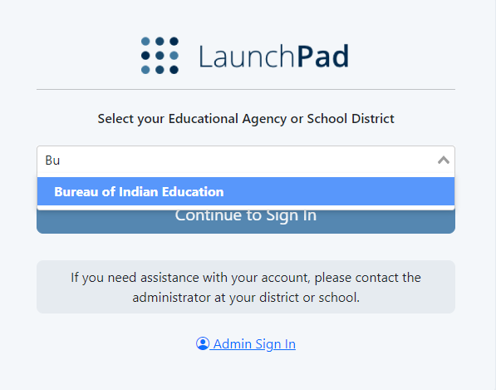
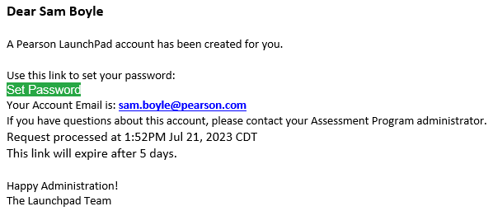
LaunchPad
LaunchPad is the single sign on (SSO) for all Pearson testing products used by the BIE. A welcome email from LaunchPad System will be sent to IT staff, School Administrators, & Test Coordinators with a link to set a password.

Slide 32
New Users in LaunchPad
Once new users are added to LaunchPad, they will be sent a welcome email with a link to set their password.
When a new user selects the link, they will be asked to update to a password of their choosing. Links expire after 5 days.
After successfully logging into LaunchPad, users should be able to select ADAM from the available application tiles.

Slide 33
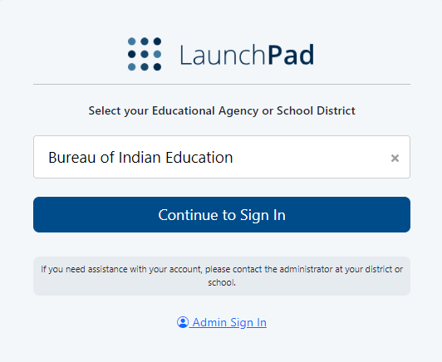
LaunchPad Login
Once a password has been set, to login to LaunchPad navigate to https://launchpad.pearson.com/#, select Bureau of Indian Education from the Educational Agency or School District list, then select Continue to Sign In.

Slide 34
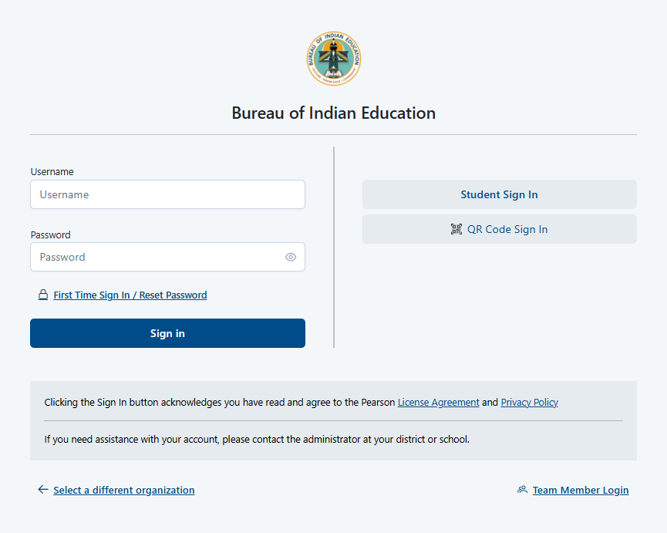
LaunchPad Login
On the Bureau of Indian Education sign in screen, enter your username & password and select Sign In.

Slide 35
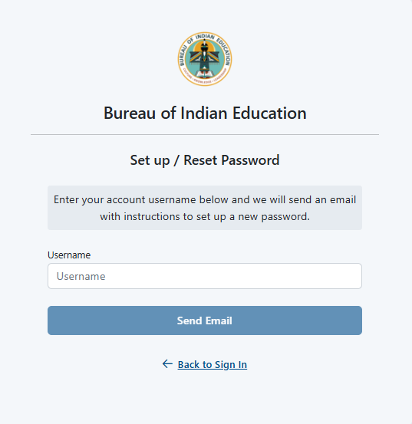
Reset Password
If you are having issues logging in, click the First Time Sign in / Reset Password then enter your username to send a reset email to the associated email account.

Slide 36
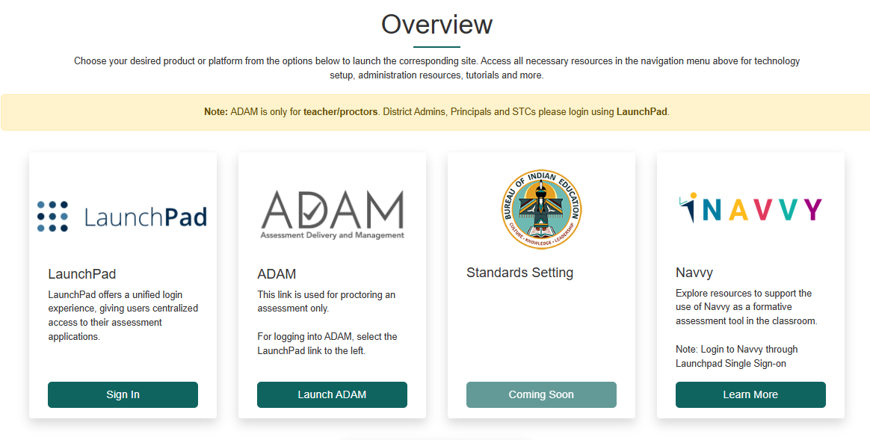
Accessing LaunchPad
Users can easily access the LaunchPad SSO link at https://bie.mypearsonsupport.com.

Slide 37
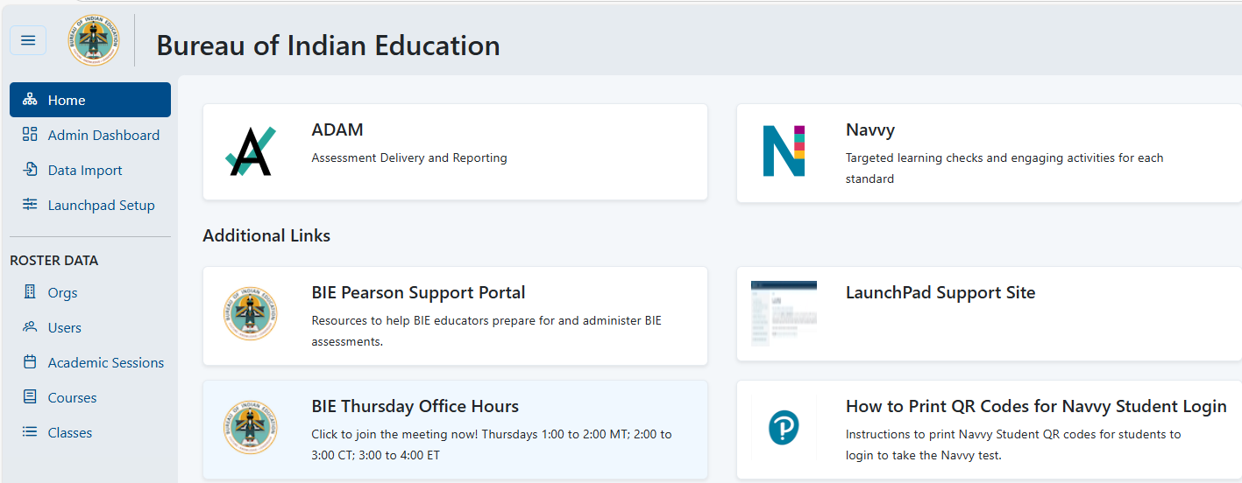
ADAM Login from LaunchPad
Once logged in to LaunchPad, select the ADAM tile from the available apps. Once selected you will automatically be logged into ADAM.

Slide 38

ADAM
ADAM is the test management platform used to administer Summative assessments.
ADAM allows users access to the Summative and Training administrations and is also used to create proctor groups and print student test cards, which students will use to log in into the assessment application TestNav.
ADAM is also the platform for accessing student assessment results and reports. More information on results and reporting will be provided later in the training.

Slide 39
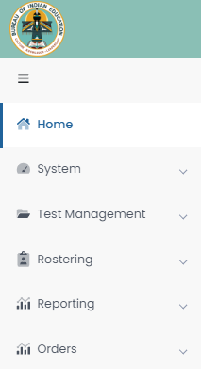
ADAM Menu
Home – Main landing page where Bulletins, including announcements, will be posted.
System – User Profile information can be accessed here.
Test Management – Available test administrations & practice tests can be accessed and administered here.
Rostering – Academic sessions information and Users information can be accessed here.
Reporting – Available reports can be viewed and downloaded here.
Orders – Additional Orders can be placed and tracked here.

Slide 40
User Roles in ADAM
School Admin – principal and/or assistant principal
Test Coordinator
Information Technology
*Teacher
*Test Administrator
*Any User that administers tests to students in ADAM is considered a proctor. An active User role in ADAM is not required to proctor/administer a test, only a valid Test Code and Proctor Password provided by the school Test Coordinator. Staff proctoring a test in ADAM will use the credentials provided by their Test Coordinator to login at https://ltr.adamexam.com/#/proctor.

Slide 41
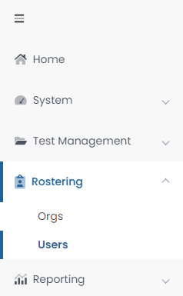
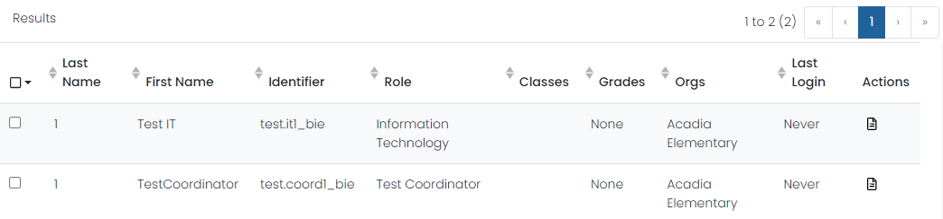
Verifying Users in ADAM
Select Rostering in the menu, then select Users, and you will see a list of users and last login status in your organization. If a user’s last login status shows Never, that means they have not yet accessed the platform. If any former staff that no longer serve BIE schools still have active User accounts, deactivate their record from ADAM and NASIS.

Slide 42
Rostering in ADAM via API
Roster data is loaded automatically into ADAM through LaunchPad. All Student User information will be pulled from NASIS through the application programming interface (API).
These API roster imports will include:
New students
Student transfers (school to school or district to district)
Data updates (DOB, name, demographic information, etc.)
NOTE: Accommodations will NOT be updated via roster imports; it is the responsibility of the school Test Coordinator to update accommodations in ADAM.

Slide 43
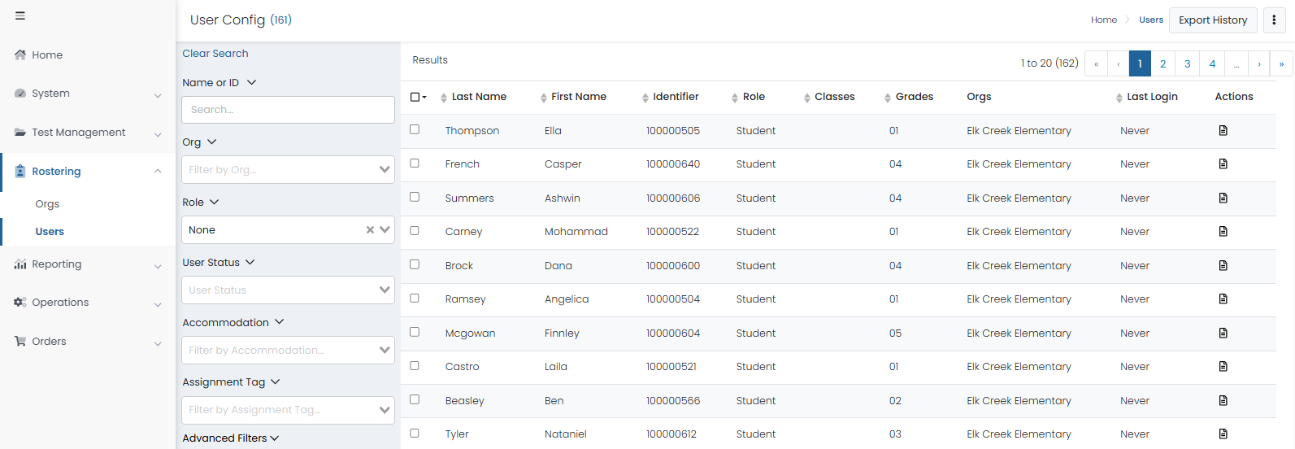
Viewing Roster Data in ADAM

Slide 44
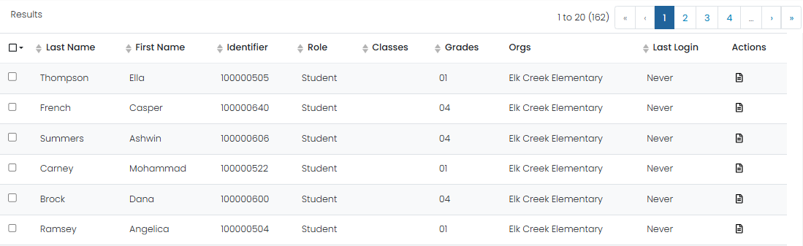
Students in ADAM
To view Student Demographics, on the Users screen select the Edit button under Actions from the list of all Students uploaded to ADAM for your organization.

Slide 45
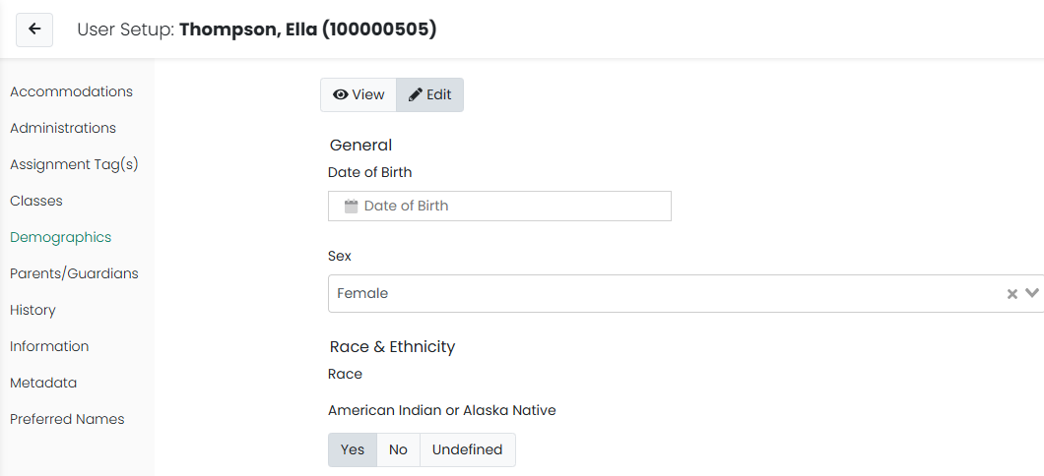
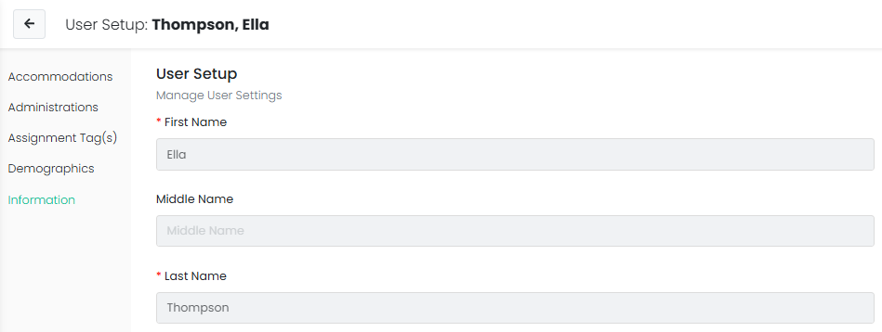
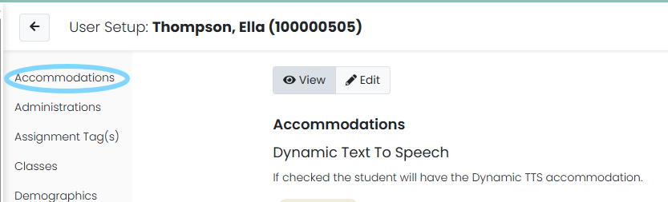
Student User Setup Page
Users with the Test Coordinator role will have access to Student roster information and can use the User Setup screen to view demographic data and confirm and update accommodations.

Slide 46
Verify & Update Student Accommodations in ADAM
All students MUST have accommodations updated in ADAM by February 4, 2026.
This is very important as this data drives the initial orders sent to your schools for Online and Paper tests, manuals, and accommodated materials.
Test Coordinators will need to:
Verify all Student data loaded is accurate.
Update or add student accommodations.

Slide 47
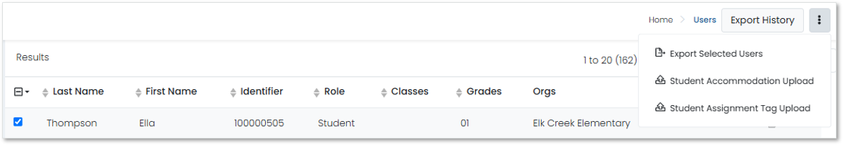
Export Users in ADAM
Select Rostering​
Select Users​
Select the specific student and/or non-student users for export​
Click the kabob menu in the upper right and select Export Selected Users​

Slide 48
Accommodations in ADAM
Accommodation | ELA/Math | Online/Paper
Read Aloud / Human Reader | Both | Online/Paper
Human Signer | Both | Online/Paper
Dynamic Text to Speech | Both | Online
Answer Masking | Both | Online
Color Contrast | Both | Online
Braille | Both | Paper
Large Print | Both | Paper
Paper | Both | Paper
Student must have a 504 or IEP for assigned accommodations

Slide 49
Accommodated Forms Hierarchy
Students with multiple accommodations will be assigned to a form that supports all or most of their form determinant accommodations as outlined in the table below.
Online Form Assignment Order | Paper Form Assignment Order
Human Signer Dynamic Text to Speech Human Reader | Braille Human Signer Read Aloud Large Print Paper

Slide 50
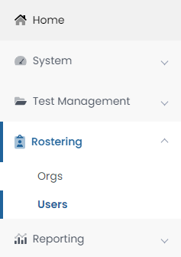
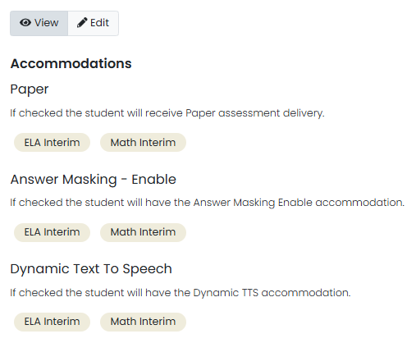
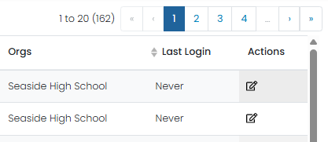
Assigning Accommodations in ADAM
School Test Coordinators will be responsible for applying student accommodations prior to testing. Accommodations can be applied either to each individual Student record or in bulk via a data import using the Student Accommodation Upload option.

Slide 51
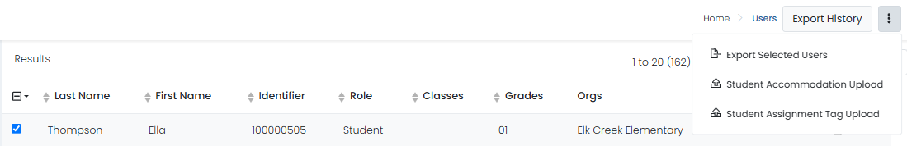
Student Accommodation Upload in ADAM
Select Rostering, then select Users.
Search for the students you want to view or update (set the Role filter to "Students"). You can search for all the students in a school or a single grade.
Select the checkbox in front of each student you want to update. You can select the checkbox at the top of the list to select all students in the search results or on the current page.
Select the ellipses on the top right, then select Student Accommodation Upload.
Follow the on-screen instructions on the Student Accommodation Upload and Update Students via CSV page.

Slide 52
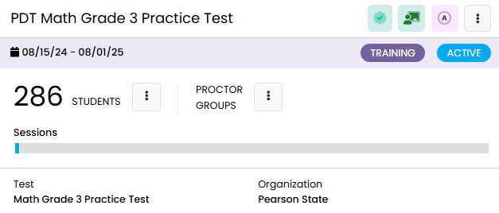
Test Administrations in ADAM
Test administrations will be set up in ADAM by Pearson. Students will automatically be assigned to a test administration based on grade-level eligibility.
Administrations in ADAM feature three primary sections:
Students – a list of all eligible students for a particular test.
Proctor Groups – view or create testing groups.
Sessions – view student progress.

Slide 53
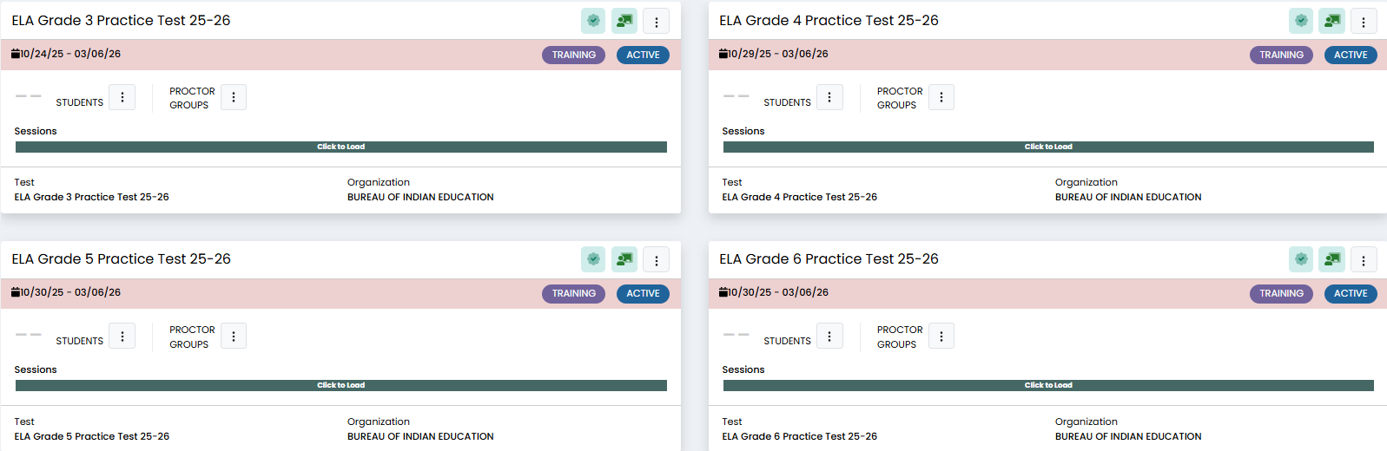
Practice Tests in ADAM
Training administrations, or practice tests, are available in ADAM by navigating to Test Management, then Training Administrations. These training admins can be used to proctor secure practice tests, including for the Infrastructure Trial.
Notes:
Please note that grade 8 math and ELA and grade 11 ELA and Algebra II practice tests are not available in ADAM as of January 2, 2026, but they will be available soon.

Slide 54
Proctor Groups in ADAM
Proctor groups are groupings of students, created by school Test Coordinators, that will be tested together and/or be tested by the same test administrator.
Students can be grouped by:
Class
Administration consideration (i.e. small group)
Subject (i.e. Algebra II)

Slide 55
Proctor Groups & Paper-based Testing
Students who will be testing Paper do NOT need to be added to a proctor group in ADAM.
All Paper-based testing students will need is the Paper accommodation applied to their record in ADAM.
  If a student assigned the Paper accommodation in ADAM needs to test Online, the Paper accommodation must first be removed.

Slide 56
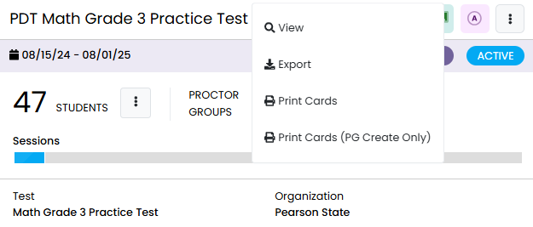
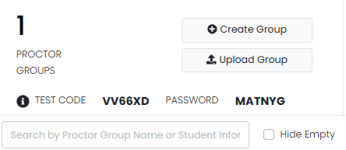
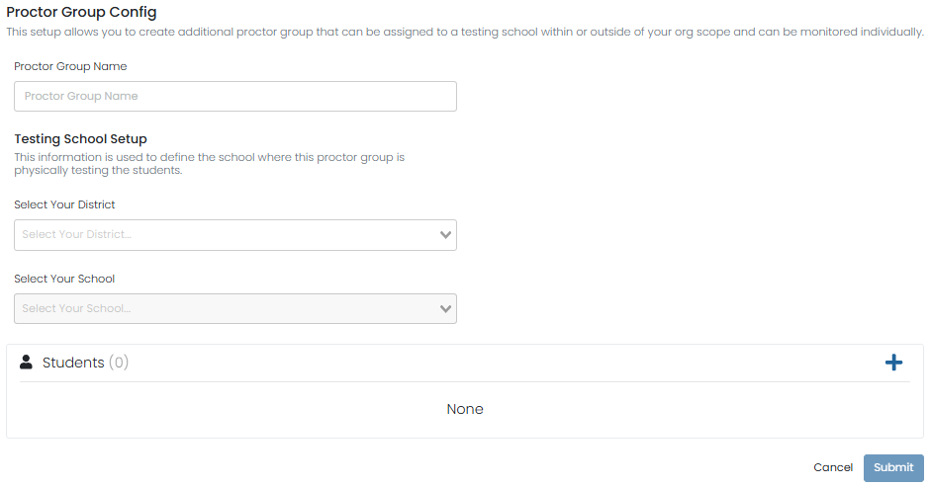
Creating Proctor Groups
To create a new proctor group:
Select the PROCTOR GROUP ellipses menu on a given test admin, then select View.
Select Create Group.
Complete the form for each proctor group you are creating.
If you’re assigning students, click the + button and then select students to assign to the proctor group.
Click Submit to save the new proctor group.
Once proctor group(s) are created the Test Coordinator can then provide each proctor with the unique test code and password for proctor login.

Slide 57
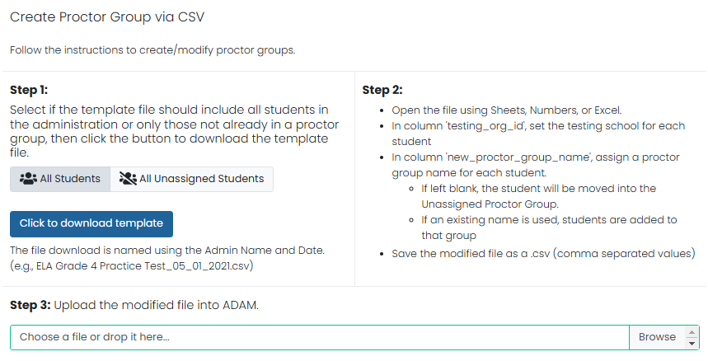
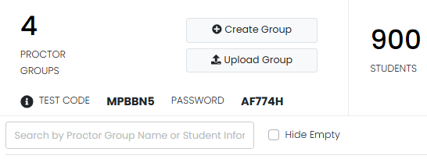
Proctor Group Upload
As an alternative to creating each proctor group in the ADAM user interface (UI), Test Coordinators can also use the Upload Group option to create proctor groups through a bulk file upload.
After selecting Upload Group, you’ll be taken to a new screen that provides step-by-step instructions on downloading the template file, updating the file, and uploading into ADAM.

Slide 58
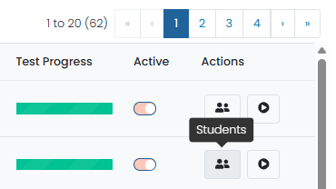
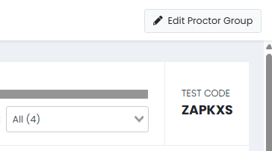
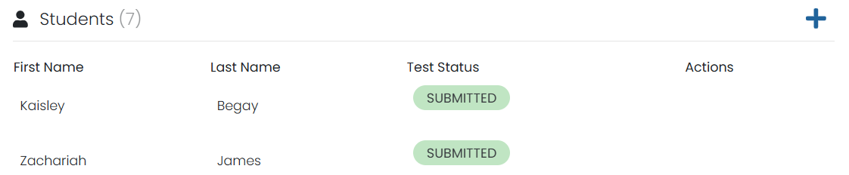
Add Students to Existing Proctor Groups
Go to Test Management and select Administrations.
In the appropriate administration card, select View under Proctor Groups.
Select Students under Actions.
Select Edit Proctor Group.
Select the + icon to assign additional students to the proctor group.

Slide 59
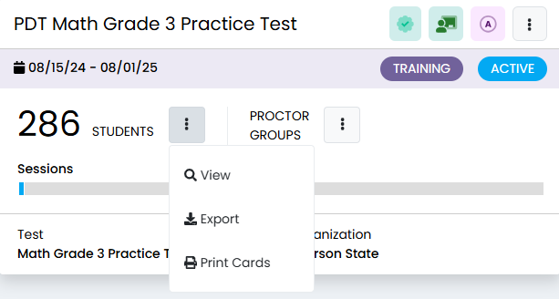
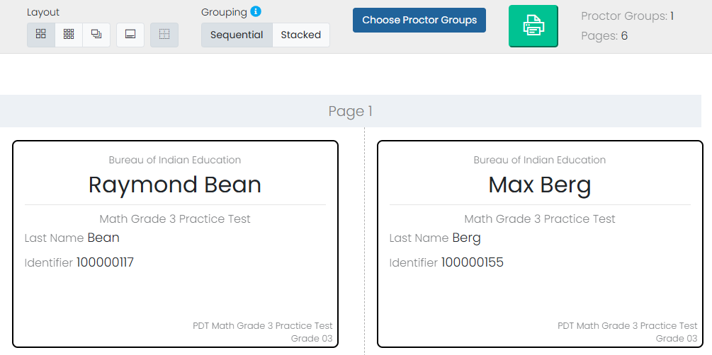
Printing Test Cards
Locate the administration card, and then under either Students select Print Cards.
You can select various formatting options:
  Layout - Select 2 by 4, 3 by 6, or 1 per page.
  Toggle title pages for each proctor group - Select whether to include title pages for each proctor group. This prints a roster for the proctor.
  Toggle borders - Select whether to include dashed borders (guides for cutting the cards).
  Grouping - Sequential or Stacked. Select the information icon to see formatting conventions for each option.
Select the Print button.

Slide 60
Before Testing Checklist

Slide 61
Test Coordinator Tasks
Confirm that the TestNav app has been downloaded/updated for all devices (conduct well in advance before the testing window opens). Your school will need to coordinate with your local IT to complete this task, where necessary.
Confirm that all devices can connect to the school network.
Unpack Secure and Unsecure test materials.
Conduct an Infrastructure Trial.
Review the Test Coordinator Manual and Test Administration Manuals.
Review the Accessibility Features and Accommodations Manual (AF&A).
Train teachers and staff on testing expectations.
Print student test cards.

Slide 62
Test Security
Materials are kept in a central, secure, and locked location with limited access.
No duplication of secure materials is permissible.
All involved personnel understand security protocols.
All involved personnel have signed security agreements. (https://bie.mypearsonsupport.com/training-resources/).
Test environments are secured against unauthorized personnel.
Use a chain of custody (https://bie.mypearsonsupport.com/training-resources/).

Slide 63
Test Materials Security
Secure
Student test cards
Paper-based test booklets
Paper-based answer documents
Used scratch paper
Any student work/responses
Mathematics and ELA reference sheets (prior to testing)
Any material written on that cannot be reused
Non-secure
Test Administrator Manuals (TAM)
Test Coordinator Manual
Unused scratch paper

Slide 64
Initial Shipment of Test Materials
Initial shipments of test materials will be received 1-2 weeks prior to the test start date.
You MUST have all student accommodations updated in ADAM by February 4, 2026 to ensure you receive the appropriate testing materials.
PreID labels, stickers with scannable barcodes that can be placed on student Paper answer documents containing student information, will only be shipped with the initial shipment of test materials and cannot be ordered through the additional order process.

Slide 65
Initial Shipment of Test Materials
Test Coordinator Kit
Resealable plastic bag (holds all materials)
Paper bands
Pearson Scorable and Nonscorable labels (2 different colors)
UPS Ground return labels for Scorable and Nonscorable materials
Student preID labels and roster
Return instructions sheet
Shipping carrier return instructions
Packing list and chain of custody form
Test Coordinator Manual
Test Administrator Manuals
Student test materials
  Test booklets/answer documents
  Math Reference Sheets, rulers, and protractors, if applicable
  ELA Reference Sheets
  Large Print/Braille kits
  Human Reader kits

Slide 66
Initial Shipment of Test Materials
Accommodation | Students testing Online | Students Testing Paper
Human Signer - Math | Test book used as a Human Reader script that includes same questions as the online human reader test is shipped to school . | A Human Reader Kit is sent to school. Kit contains: Two student test books, student answer document, ruler-protractor-math reference sheet as needed.
Human Signer - ELA | Test book used as a Human Reader script that includes same questions as the online human reader test is shipped to school . | A Human Reader Kit is sent to school. Kit contains: Two student test books, student answer document, ELA reference sheets.
Human Reader/Read Aloud - Math | Test book used as a Human Reader script that includes same questions as the online human reader test is shipped to school . | A Human Reader Kit is sent to school. Kit contains: Two student test books, student answer document, ruler-protractor-math reference sheet as needed.

Slide 67
Initial Shipment of Test Materials
Accommodation | Students testing Online | Students Testing Paper
Human Reader/Read Aloud - ELA | Test book used as a Human Reader script that includes same questions as the online human reader test is shipped to school . | A Human Reader Kit is sent to school. Kit contains: Two (2) Student test books, student answer document, ELA reference sheets.
Large Print | N/A | A Large Print Kit is sent to schools. Kit contains: Student test book, student answer document, ruler-protractor-math or ELA reference sheet as needed

Slide 68
Receipt of Test Materials
Upon receipt of test materials, Test Coordinators should:
Remove the Packing List, chain of custody Form, and Test Coordinator Kit from Box 1.
Inventory materials immediately to verify that all were received and that there is an adequate number for administration.
  Count the number of shrink-wrapped packages only. Shrink-wrapped packages may be opened four school days before testing.
Optional: take preID labels out of School Coordinator Kit.
Test Coordinators may order additional material in ADAM, if necessary.
Keep all test materials in a centrally locked storage area, with limited access, until testing.
  Ensure that chain of custody procedures are always followed.

Slide 69
Receipt of Test Materials
Document any movement of secure materials before, during, and after testing.
Schools inventory materials using the chain of custody.
Deliver paper-based forms and materials to Test Administrators (oral scripts) only on the day of testing, using a chain of custody process.
Distribute only the content area being assessed.
  As close to testing time as possible
Return materials to a designated secure location.
  Not stored in classrooms
  As soon as possible after the unit is complete
Test Administrators return secure materials to Test Coordinator after testing is completed, including test books used as Human Reader scripts.

Slide 70
Chain of Custody Forms
Use a new school chain of custody form for each day of testing the form must include:
  Security barcode/number
  Test Administrator signature
  Date and time checked out
  Test Coordinator (or designee) signature for return
  Date and time returned
Chain of custody forms are kept on file for three years. If materials are missing, these will be requested.
Chain of custody forms can be found on the BIE Portal under Administration Resources/Summative Resources/Additional Resources/Forms: Resources | BIE Portal

Slide 71
Documenting & Storing Test Materials
Keep all boxes in which the test materials were delivered and use them to return Scorable and Nonscorable materials after testing is completed.
Report the following occurrences immediately to BIE using the Form to Report Contaminated, Damaged, or Missing Materials (see Appendix E of Test Coordinator Manual):
  Non-receipt of any materials listed on the School Packing List
  Discovery of damaged test material
  Discovery of missing or duplicate sequence numbers on any Test Booklets

Slide 72
During Testing

Slide 73
Additional Order Window
Summative Additional Order (AO) window:
Order at least 5 days prior to test administration but after the initial order is received.
It is the school Test Coordinator’s responsibility to understand the additional order window and return dates and process.
 | Dates
Additional Order window | March 9 – May 1, 2026
Return Materials (Scorable) | May 4, 2026
Return Materials (Non-Scorable) | May 15, 2026

Slide 74
Additional Orders
Orders can be only be submitted in ADAM by the Test Coordinator.
BIE will only approve additional orders for accommodated materials if the ordered materials can be matched to a student registration in ADAM.
  Once an order is placed, contact the BIE so they can review and approve as soon as possible.
Accommodations information must be entered on the student's profile before placing the additional order.

Slide 75
Additional Orders
Keep in mind when ordering additional material:
Do not submit AOs prior to receiving the initial shipment of test materials.
PreID labels for Paper tests will NOT be sent with AOs.
All test materials should be inventoried prior to placing an AO.
Once an AO is approved, please allow 4-5 business days for shipment and delivery.

Slide 76
Additional Orders
Keep in mind when ordering additional material:
Ancillary materials for return shipping are not automatically included in the AO.
  Shipping labels
  Mathematics tools
  Reference sheets
Account for the need of these additional materials when an AO is placed.
Check for return labels prior to the end of the testing window as these will not have expedited shipping.

Slide 77
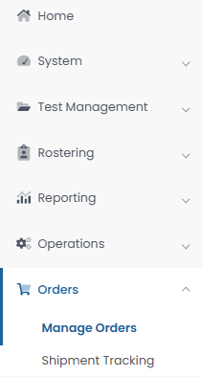
Creating Additional Orders in ADAM
To place an additional order in ADAM:
Select Orders, then select Manage Orders.
Select Create Order.
Fill out all required information for the new additional order on the Order Details screen, then select Go to Order Items.
Add all needed items and item quantities, then select Go to Confirm Order.
Confirm the details and items for your additional order, then contact BIE to approve your order.

Slide 78
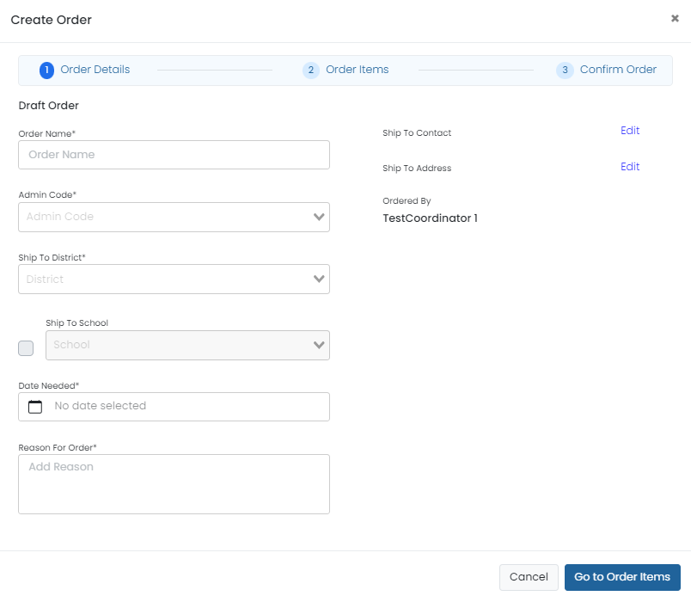
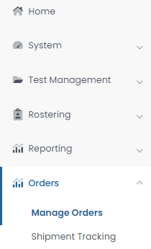
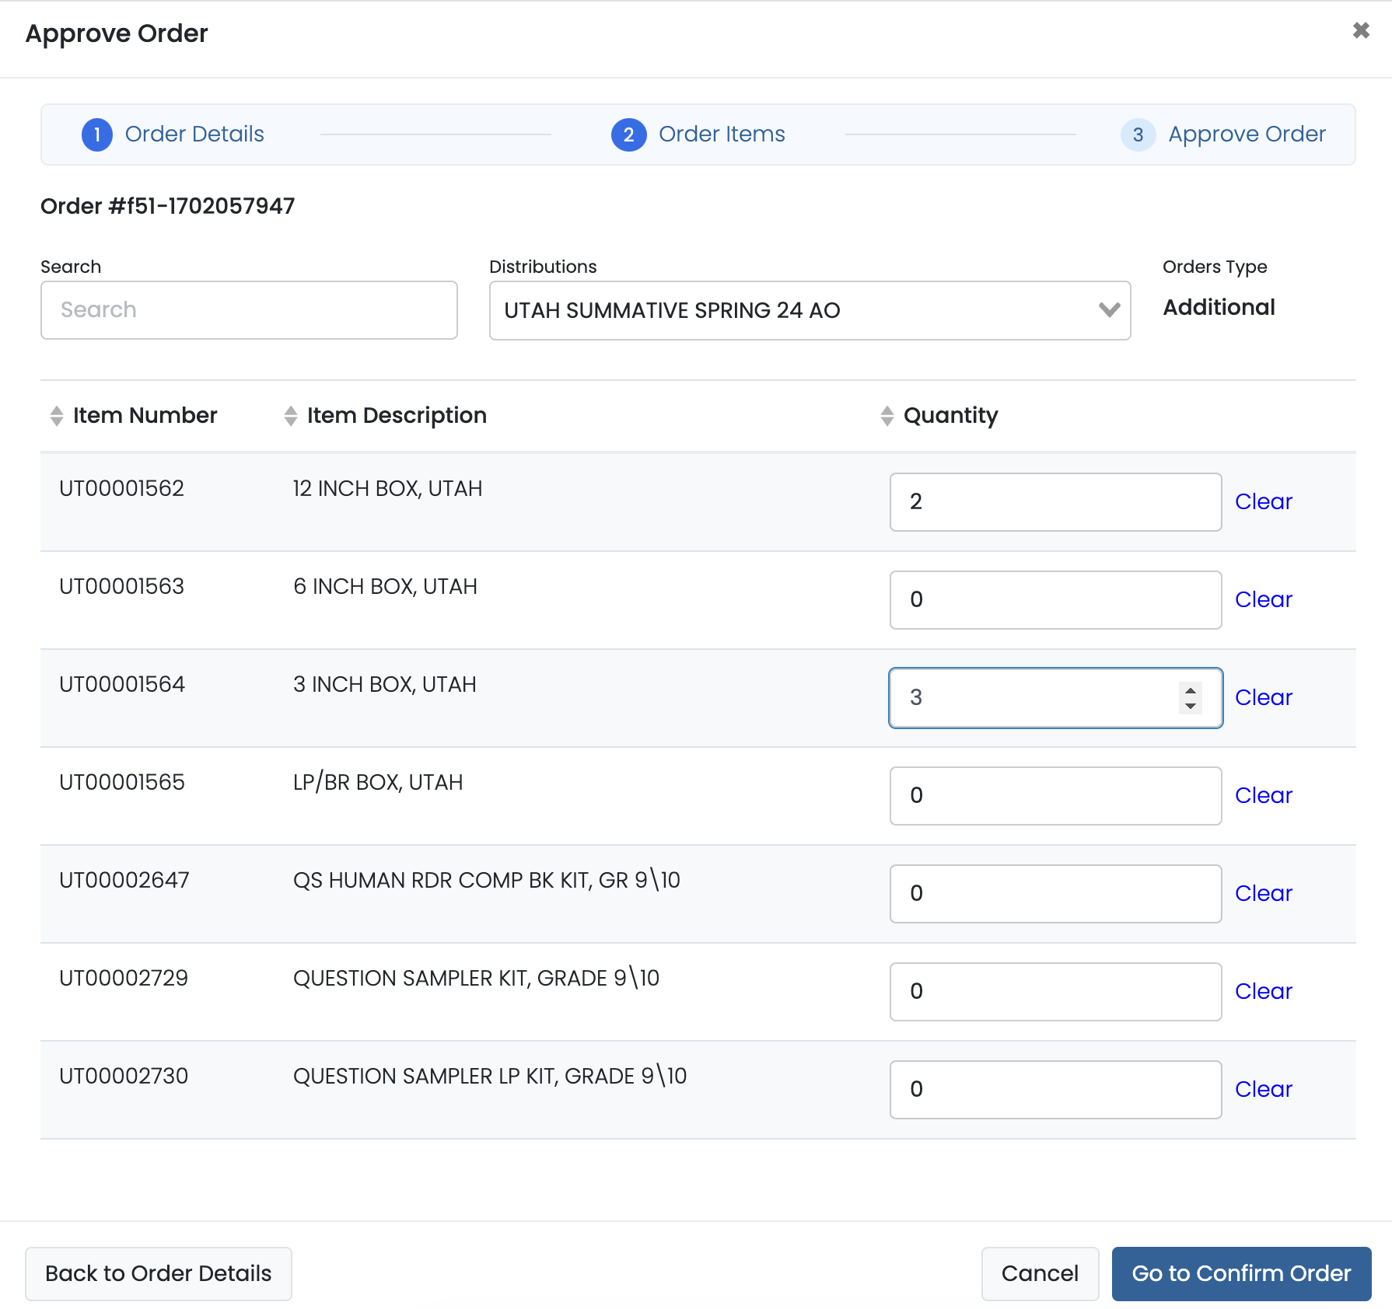
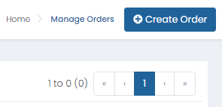
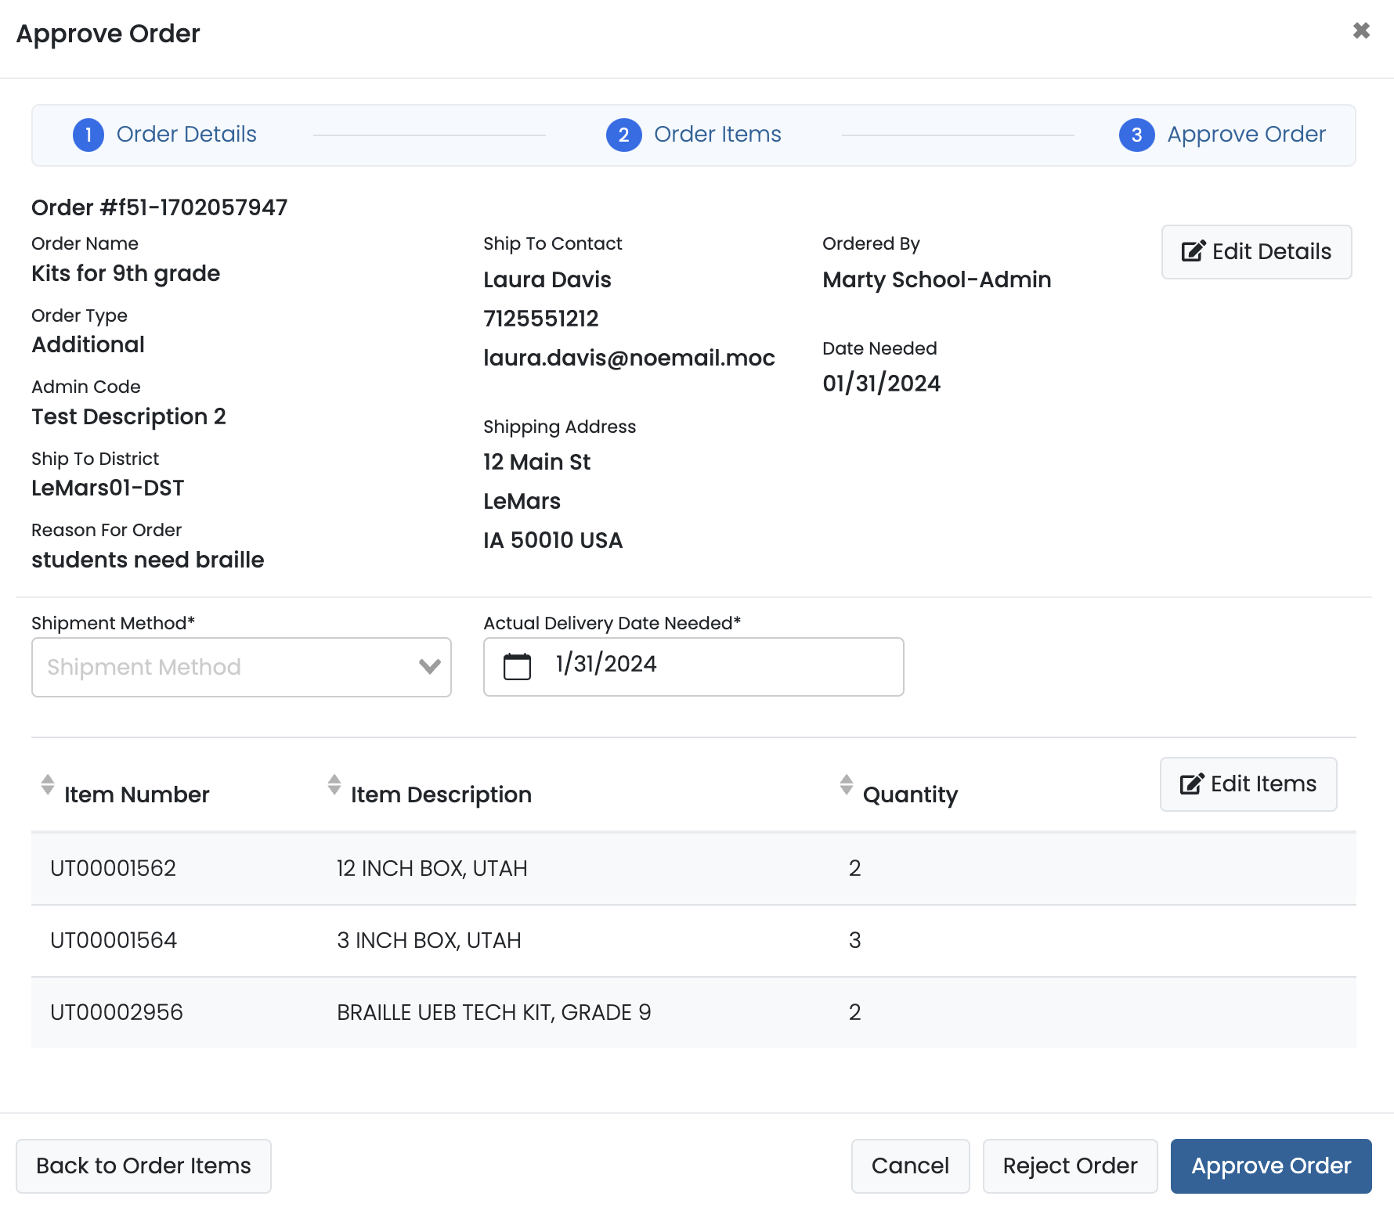
Creating Additional Orders in ADAM

Slide 79
Proctoring in ADAM
School staff proctoring/administering Summative tests in ADAM will NOT have a user profile in LaunchPad.
Test administrators, teachers, and any certified staff proctoring tests will access the ADAM proctor dashboard by logging in at https://ltr.adamexam.com/#/proctor.
The proctor dashboard allows proctors to approve & begin student tests, monitor test session progress, and update student statuses as needed.
Test Coordinators will also be able to access proctor dashboards for all proctor groups created at their school.

Slide 80
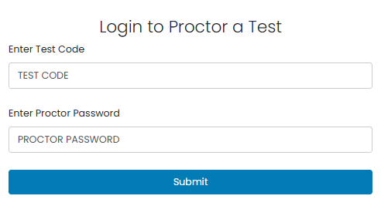
Proctor Login
Navigate to https://ltr.adamexam.com/#/proctor.
Enter the test code & proctor password (provided by the Test Coordinator).
Select Submit.

Slide 81
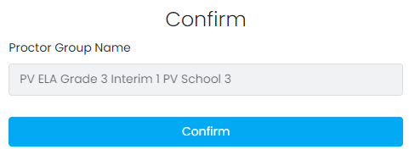
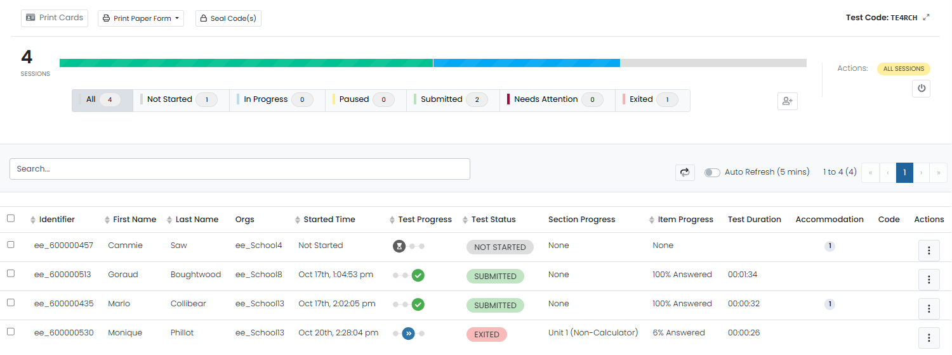
Proctor Login
Select Confirm on the next screen.
Type your proctor first name & last name.
Select Save.
Proctor dashboard will then load.

Slide 82
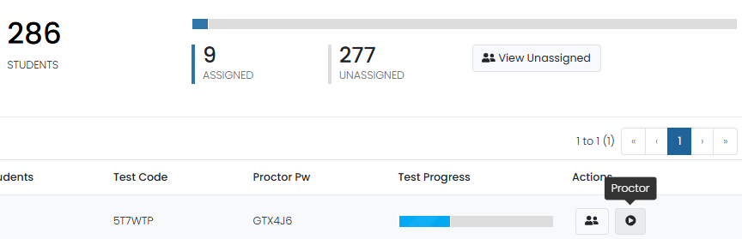
Monitoring Proctor Groups
School Test Coordinators can monitor student testing status by selecting View under Proctor Groups on the admin card, then selecting Proctor under Actions for a particular proctor group. This will take you to the proctor dashboard for that proctor group.

Slide 83
ADAM Proctor Dashboard

Slide 84
Proctor Dashboard Details
Assessment Information – Here you can view information about the test, test configuration, and select an action.
  Testing Information – Includes Test, Administration, and Proctor Group
  Config Information – Includes Test Window, Proctor Name, and Kiosk Only field
  Actions – Includes Test Code, Proctor Password, Seal Codes, and Print Cards link
Student Session List – Here you can view, filter, search for students in your proctor group and manage their sessions and apply accountability codes as needed. Students that can access the test appear in the Tester column.

Slide 85
Test Status
The Test Status column displays the students’ progress as one of the following:
Not Started – The student has not signed in to test. No action is needed by the proctor.
Needs Attention – The student requires action by the proctor, such as needing their test approved by the proctor.
In Progress - The student has signed in to the test. No action is needed by the proctor.
Submitted - The student has completed the test and submitted their answers.
Reseat – The proctor has reseated the student. The student has not yet signed back in to the session. No action is needed by the proctor.
Exited - The student has exited TestNav and the proctor must reseat them before they can log in to the test again.

Slide 86
Actions
After the assessment session has started, a set of options appears in the Actions column for each student. Proctors use these options to control individual student’s sessions:
Approve Session – Proctors will need to select Approve Session for any student with a Needs Attention status for the student to begin their test in TestNav.
Reseat Session – Proctors can select this if a student exits TestNav before submitting their test or if something interrupts a student's session. This might include a computer issue, session timeout, or an unexpected error. Reseating allows the student to re-enter their test code and login ID to continue taking their test.
Submit Session - Proctors can select this if a student finishes their test but does not submit the test before exiting.
Unsubmit Session - Proctors can select this if a student mistakenly submits their test.

Slide 87
Seal Codes
The test administrator will distribute seal codes for each test unit.

Slide 88
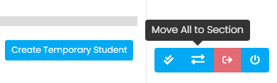
Move to Section
Spring Summative tests are multi-section/multi-unit assessments, so proctors have the option to define the section/unit a student starts in. Once the proctor moves a student, the next time the student logs into the test they will start in the new section/unit.
All students can be moved to the same section in bulk using the Move All to Section button in the header of the Proctor Dashboard, or students can be assigned to start in a section using the Move to Section action in the kabob menu.

Slide 89
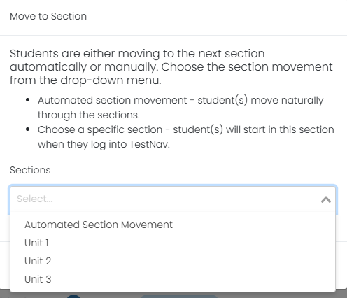
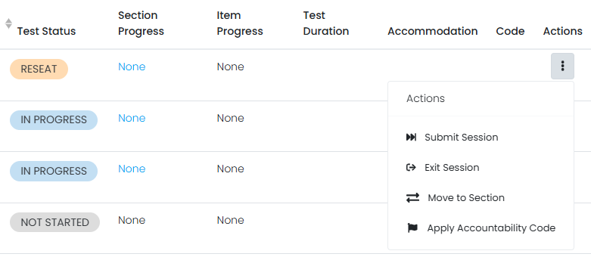
Move to Section
Proctors or Test Coordinators should only move students to a specific section or unit of a test for the following reasons:
A student was absent for a day of testing and needs to start on a specific section/unit to test with their proctor group.
A student completed certain sections/units of the test during scheduled testing time but was unable to complete the test due to unforeseen issues, such as an illness, and will need to finish during scheduled makeup testing.

Slide 90
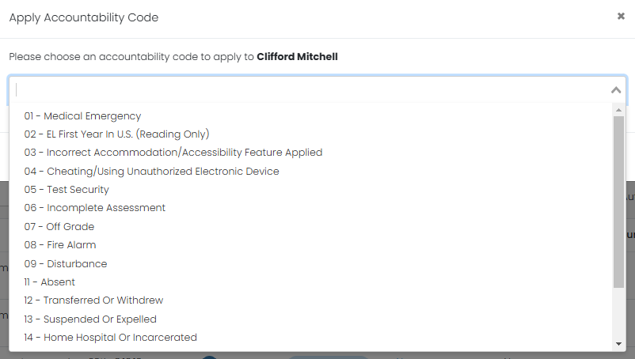
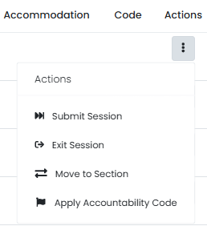
Accountability Codes
Accountability codes provide a way for designated users to tag students who should not test, or who were tested but should not appear in reporting. The available codes, what they do, and who can add them depends on your site implementation. These can be applied in the proctor dashboard or from any administration student list. Accountability codes can be applied during the testing window or directly after testing is complete (no later than May 8).

Slide 91
TestNav

Slide 92
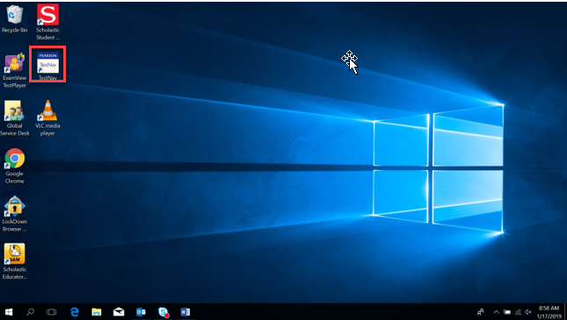
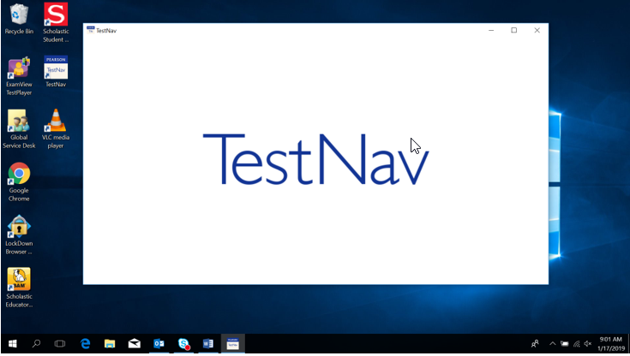
TestNav Access
Students will select the TestNav icon from their computer desktop.

Slide 93

TestNav Access
If not already chosen, students will need to select BIE from the customer list.

Slide 94



TestNav Sign-In
Students input the Test Code provided by the proctor & Last Name and NASIS ID from their test card. The student will then confirm the information is correct and select next to begin their test.

Slide 95
TestNav Blocklist
The TestNav application will be blocked from opening if any of the below applications are running on a student device:
Firefox
Google Chrome
Internet Explorer
Safari
Microsoft Edge
Cisco Webex
Cisco Jabber
Citrix GoToMeeting
Facebook Messenger
Yahoo Messenger​
Google Talk​
Outlook​
Snap Chat​
Skype​
Teams​
WhatsApp​
Zoom​
Amazon Music​
iTunes​
Pandora​
iHeartRadio​
Spotify

Slide 96
TestNav Troubleshooting
If Students are experiencing issues logging into their test in TestNav, here are some common troubleshooting tips:
Confirm the student is using the login information provided on their test card.
Check to see if the student is in a Needs Attention status in the proctor dashboard and, if so, approve their test.
Confirm that no blocked applications are currently running on the student’s device.
Ensure that your school’s network is stable and ready to support Computer-based testing (perform the recommended Infrastructure Trial prior to testing or work with IT staff if available).
If a student login to TestNav fails, or if a student exits the test, Reseat the student in the proctor dashboard.
If issues persist, take note of the error code or error message provided in TestNav and contact Pearson Customer Support.

Slide 97
During Testing Checklist

Slide 98
Test Environment
The testing environment must:
Be adequately lit, quiet, free of distractions, and heated or cooled.
Provide an adequate writing surface (Paper-based).
Be free of electronic devices and music.
“Do Not Disturb/Only Authorized Personnel Allowed” sign must be placed on the door during test sessions.

Slide 99
Test Environment
No food or drinks are allowed on desks or near test materials.
The testing environment must be free of any content related posters or aids that suggest possible answers to students:
  Word walls.
  Steps for solving math equations.
  Any content related materials.
  Any resource that defines, explains, or illustrates terminology or concepts.
When in doubt, cover it.

Slide 100
Display Testing Time
Display unit testing time for students as in the example below:
​ | Algebra II, Unit 1​
Unit Testing Time:​ | 70 Minutes​
Starting Time:​ | 9:00 AM​
Stopping Time: ​ | 10:10 AM​

Slide 101
Student-to-Test Administrator Ratio
Student-to-Test Administrator ratio must not exceed 30 to 1.
  Test Administrator must be able to actively monitor the space within the physical testing environment.
Test Administrators must:
  Actively proctor.
  Remain attentive and in the room during the entire testing unit.
  Circulate throughout the room during the test.
  See students working but not see student work.

Slide 102
Testing Room Configuration
Students should not be able to see each other’s work from a normal testing position.
Consider the following seating configurations to maintain test security:
  Seat students in every other seat (useful in a computer lab setup).
  Arrange monitors back-to-back.
  Seat students back-to-back.
  Seat students in a semicircle (useful for schools using laptops).
  Seat students in widely spaced rows or in every other row (appropriate for a classroom setup).
Dividing screens or other privacy materials may be used if students cannot be placed far enough away from each other.

Slide 103
Headphones for Computer-based Testing
Text-to-Speech for ELA & Math
  To be in a testing room with other students, headphones must be worn.
  Students must be tested separately if they are not able to wear headphones.

Slide 104
Unauthorized Visitors & the Media
Only students, Test Administrators/proctors, and authorized school, district, state personnel, or state-sanctioned test monitors may be in testing areas during administration.
Media are not allowed to have access to the tests before, during, or after test administration, or take pictures or video of testing materials or testing students.
Parents are not allowed in the testing room with their child.

Slide 105
Test Coordinator Tasks
Day of testing checklist:
Distribute test materials.
Ensure Test Administrators have a computer device to administer the test.
Monitor test activity.
Be available to Test Administrators.
Collect materials from Test Administrators after each test, as needed.

Slide 106
Test Administrator Tasks
Before testing begins:
Prepare the test environment and situate the students.
Follow directions and read the script in the Test Administrator Manual (TAM) to initiate the test session.
Hand out student test cards and scratch paper when directed (by the TAM script).
Assist students in logging into TestNav.
After testing is completed:
Collect student testing cards and scratch paper.
Confirm students have logged out of TestNav.
Confirm ALL tests are in a Submitted status after final day of testing.

Slide 107
Active Monitoring
Test Administrators/Teachers should:
Ensure students have all necessary materials for each test.
Follow test administration scripts exactly as written.
Move throughout the room during testing to ensure students are on task.
Test Administrators MAY NOT:
Provide feedback or clarify test questions.
Answer content related questions.
Interact with students in any way that would impact student responses.

Slide 108
Testing Exceptions & Security Breaches
When to submit Form to Report Testing Exception or Security Breach:
Students were grouped incorrectly – not same directions or time.
Students were given an incorrect amount of time (more or less).
Students were cheating.
Students used an unapproved accommodation or were not given an accommodation with which they should have been provided.
  Test read to students without the Human Reader / Read Aloud assigned.
Test Administrator did not follow procedures.
PBT students go past stop sign at the end of the unit.
Large number of students involved in a technology related exception.
  If technology issues cause testing to not be completed on one day.
Test security has been breached.
Student goes back into a unit on a different day and changes answers.

Slide 109
Testing Exceptions & Security Breaches
Monitoring and reporting security breaches and testing exceptions:
All instances of security breaches and testing exceptions must be reported to the Test Coordinator.
Test Coordinator will contact BIE Chief Academic Office immediately upon receiving notification.
Testing Exceptions or Security Breach
  Test Coordinator will complete the Form to Report a Testing Exceptions or Security Breach and provide to BIE.
  See Appendix D of Test Coordinator Manual.

Slide 110
Contaminated & Damaged Materials
For paper-based testers, contaminated or damaged test materials that must be replaced:
Place Student preID label on replacement document or complete entire data grid.
Record security barcode number of both the damaged and the new documents.
Submit the Form to Report Contaminated Damaged, or Missing Materials to BIE.
If possible, transcribe responses from contaminated test material into the replacement. If not, destroy contaminated material according to local biohazards protocols.

Slide 111
Safety Threats & Severe Weather
Test Coordinators will create a plan and train staff for safety threats and severe weather.
Test Administrators:
Note the time of the disruption.
Secure test materials as specified in your School Security Plan.
Prepare students for the continuation of the unit and resume students’ tests.
Document the situation in writing.
If the disruption will cause the unit to be carried over into the next day, notify BIE.

Slide 112
Prohibited Devices
ALL personal electronic equipment not related to testing (e.g., cell phones, iPods, personal document scanners, eBooks, electronic pens, smart watches, etc.) is PROHIBITED from the testing environment.
Personal electronic equipment may not be used at any time during testing, including after a student has completed testing or during a break.

Slide 113
Technology for Medical Monitoring
Students who use a phone, tablet, or other device to monitor their medical condition may have the device in the testing room.
Documentation of medical necessity must be kept at the school.
Plan for use of these devices must include:
  Where the device is located and who has control of the device.
  If the student has control, the device must always be visible and may not be used for any other purpose.
  Procedures for if/when the device alerts and what action is necessary.
If student must leave the testing environment, follow procedures for students who become ill.

Slide 114
Early Finishers
School decisions:
Will students be able to leave when they have finished testing? (no minimum time)
Sit quietly?
Read (cannot use any electronic reading devices)?
May students be released to location outside testing area?
What to do when all students are completed with unit?

Slide 115
Emergency Accommodation
A case where a student needs a new accommodation immediately due to unforeseen circumstances.
Cases could include students who have a recently-fractured limb (e.g., arm, wrist, or shoulder); whose only pair of eyeglasses have broken; or a student returning from a serious or prolonged illness or injury.
Emergency accommodation form must be completed and maintained.
Contact BIE if a student requires a paper-based administration.
Refer to Appendix G for Emergency Accommodation Form in the Accessibility Features and Accommodations Manual.

Slide 116
Student Accommodation Refusal Form
If a student refuses an accommodation, the school should document in writing that the student refused the accommodation.
Refer to Appendix H of the AF&A Manual: Student Accommodation Refusal Form.
The accommodation must be offered and remain available to the student during testing.
Test Coordinators should send a copy of the form to parents when a student refuses an accommodation documented in an IEP, 504 Plan, or EL Plan.
Forms are maintained in the student’s record.

Slide 117
Make-up Testing
Students who are absent, become ill, or who can no longer test because of classroom, school, or technical interruptions during originally scheduled units, may utilize make-up testing.
  Students may not return to previously answered questions.
Test security and administration protocols apply.
School Test Coordinators will establish the make-up testing schedules for their schools.
ELA/Math units may be taken out of order for make-up testing only.
Different grade level or course make-up tests for a specific content can be administered at the same time in the same room.
  Special attention must be paid to unit testing time and teacher direction variations between grade levels.

Slide 118
After Testing Tasks

Slide 119
After Testing Key Dates
Student test status clean-up must be completed in ADAM, and rejected paper test alerts must be resolved by May 8, 2026*.
Online tests in the below statuses should be manually submitted in ADAM.
In Progress
Exited
Reseat
*Incomplete tests will NOT be scored or reported.

Slide 120

Manual Test Submission in ADAM
If at the end of the testing window there are any students still in an Exited, In Progress, or Reseat status, those partial attempts must be manually submitted to be scored and reported.
To determine if any student tests require manual submission, Test Coordinators can review the Sessions information located on the admin card for each individual test administration or use the Progress report.
If any In Progress, Exited, or Reseat student statuses are listed under Sessions, these will need to be manually submitted in the proctor dashboard or in Session Explorer.
  Students in an In Progress or Exited status will need to be Reseated before their test can be submitted.

Slide 121

Manual Test Submission in ADAM
Test Coordinators can navigate to proctor dashboard, locate students in an Exited, In Progress, or Reseat status, select Actions, then select Submit Session.
Any student in an Exited or In Progress status will need to be Reseated before their test can be submitted.

Slide 122

Progress Report for Submitted Tests
The number of tests submitted by test can be monitored using the Progress report.
Navigate to Reporting, then select Progress. Here you can view session progress for any selected test, including the number of tests in a Submitted, In Progress, and Not Started status.

Slide 123

Activity Report for Submitted Tests
The number of tests submitted within a given window of time can be monitored using the Activity report.
Navigate to Reporting, then select Activity. Here you can view the number of test sessions that have been submitted within a selected window.

Slide 124
Reporting

Slide 125

Performance Reports in ADAM
Performance Reports will be available in ADAM after Standard Setting.
To access Summative Performance reports:
Select Reporting
Select Performance
Choose Program: Summative 2026
Select Grade and Subject
Select Performance Summary, Item Analysis, or Standard Performance

Slide 126

Summative Reports in ADAM Report Assets
Once Summative reports begin posting in ADAM, they can be accessed from Report Assets.
To access Summative reports:
Select Reporting
Select Report Assets
Locate and view reports either by selecting My Scopes or Files

Slide 127
Summative Reports
Final online reports:
Item Analysis
Performance Summary
Standard Performance
Individual Student Reports (ISRs)
Final printed reports:
2 ISRs per student per subject.
2 copies of school-wide grade level report with aggregate student proficiency data
*Please note that Growth will not be reported.
Reports will not be available until after Standard Setting meetings.

Slide 128
Summative Reports
Summative Reports will now primarily be available in ADAM Performance Reports:
Item Analysis
Performance Summary
Standard Performance
Individual Student Reports (ISRs)
These reports that were available in previous years will no longer be created:
Reporting Category Roster
Evidence Statement Analysis
Reporting Category Summary
Demographic Performance Level Summary
School Content Standards Roster
Spotlight Video Student Reports
Reports will not be available until after Standard Setting meetings are complete and cut scores/performance level descriptors are finalized.

Slide 129
After Testing Checklist

Slide 130
After Testing Tasks for Computer-based Testing
Test Administrators/Proctors after each day of testing:
Collect materials (student testing cards, scratch paper, etc.).
Ensure students have logged out of TestNav correctly.
Return materials to the Test Coordinator, as needed.
Notify Test Coordinator of absent students.

Slide 131
After Testing Tasks for Computer-based Testing
Test Administrators/Proctors & Test Coordinators on final day of testing:
Collect materials (student testing cards, scratch paper, etc.).
Ensure student test units have been submitted/completed.
Securely destroy materials that need to be destroyed.

Slide 132
After Testing Tasks for Paper-based Testing
Test Administrators/Proctors on each day of testing after each test:
Collect materials (test booklets, answer documents, scratch paper, etc.).
Ensure names are on test materials.
Return materials to the Test Coordinator using chain of custody form.
Notify Test Coordinator of absent students and/or students who need transcriptions.

Slide 133
After Testing Tasks for Paper-based Testing
Test Coordinators on final day of testing:
Collect materials (test booklets, scratch paper, etc.).
Ensure preID labels are affixed or data grids are completed.
Return scorable materials to Pearson as soon as possible (no later than May 4, 2026).
Securely destroy materials as outlined in the Test Coordinator Manual.
NOTE: If scorable materials are NOT picked up by May 4, 2026 there is NO GUARANTEE that paper-based tests will be scored.

Slide 134
Rejected Tests
If there is no preID label affixed to a Paper answer document the answer document will be scanned into ADAM.​
ADAM will then match the test to the student by First name, Last name, DOB, & Student ID. The system will attempt to auto-resolve any answer docs without a preID label.​
Any tests that are cannot be auto-resolved in ADAM will appear as a rejected test and must be resolved by May 8, 2026.​
If rejected tests are not resolved by the deadline Pearson cannot guarantee the test(s) will be scored & reported.

Slide 135

Rejected Tests in ADAM
In ADAM, under Operations, you’ll be able to select Rejected Tests and review any rejected tests for your school and resolve by assigning to the correct student record in ADAM.​

Slide 136
Rejected Tests in ADAM
Go to Operations > Rejected Tests.
You can search for a test by:
  Student – Enter a student's first and/or last name or the student's ID.
  Test – Enter a Test name or form code.
  Org – Select an organization.
Click a rejected test to open the Rejected Test Assignment popup.
Search for and select the appropriate student, and then click the Assign to Student button to assign the test to the selected student.
​

Slide 137

Student PreID Labels
Student preID labels will only be shipped for students assigned the Paper accommodation in ADAM by February 4, 2026.
This is extremely important for any student needing a paper accommodation.
Student preID label will go directly on the student’s test booklet (grade 3) or answer document (grades 4-8 & 11). Using a label helps ensure we have the correct information for the student to complete scoring.
If a student preID label is not used and Pearson is unable to match the student to a record in ADAM, an alert will be created. This may need to be resolved by the school.
EXAMPLE

Slide 138
Student PreID Labels
The student preID label will override any bubbled demographic information.
Set aside student preID labels that were not used to be securely destroyed/shredded.
If a preID label is not available, grid all the fields on the data grid (must match info in ADAM).
  Incomplete or incorrect bubbling will lead to rejected student tests that must be resolved.

Slide 139
After Testing Tasks
Test Coordinators after your school completes ELA/Math testing:
Organize and return nonscorable test materials.
  Identify transcribed and damaged test materials as “Do Not Score.”
Complete a Post-Test Certification.
Resolve any rejected test alerts in ADAM by May 8, 2026.
Destroy/shred scratch paper and used Mathematics and ELA Reference Sheets.
Keep records for three years.

Slide 140
After Testing Tasks for Paper-based Testing
Transcription guidelines:
Complete Contaminated Document if needed.
At least two persons must be present during any transcription of student responses.
  One person to transcribe.
  One person to verify the transcription.
The Test Administrator shall transcribe the student responses.
The other must be a certified BIE educator to verify the transcription.
The student’s responses must be transcribed verbatim into the Answer Document.
Note for Braille transcription: Only a Braille certified proctor may transcribe student responses.
After transcription, shred any responses made from an assistive technology device.

Slide 141
Separating Material Returns
Scorable and nonscorable are returned separately.
DO NOT mix these materials in boxes.
Different colored labels by program for scorable and non-scorable.
Assessment | Scorable | Nonscorable
ELA/Math | Red | Purple

Slide 142
Return Shipping Labels
Ensure that you have return shipping labels.
  These are shipped with the school coordinator kits.
These will not be overnighted, so make sure that you have these in time to return materials.
  Scorable picked up by May 4, 2026*
  Nonscorable picked up by May 15, 2026
*If scorable materials are NOT picked up by May 4, 2026 there is NO GUARANTEE Paper-based tests will be scored.

Slide 143
Preparing Materials for Shipping
Checklist to prepare materials for packing:
Scorable test booklets/answer documents have a Student preID label or hand-gridded student demographic and school data.
Scorable and nonscorable materials are packed separately for ELA/Math and are in the boxes in which they were delivered.
Boxes are not overfilled (under filled boxes are packed with crumpled paper).
One return shipping label (scorable or nonscorable) and one UPS label is placed on the top of each box.

Slide 144
Returning Secure Materials
Secure materials must be returned
Every test booklet, answer document, and paper test book used as a human reader script has a secure barcode and will be tracked.
Every secure test item must be returned, including test books used as human reader scripts.
Make sure that all materials are accounted for and returned.
If something must be destroyed locally (contaminated) then communicate with the BIE prior to destruction for further instructions.
Keep track of your UPS tracking numbers when shipping back materials.

Slide 145

Packaging Reminders
Packing Scorable materials:
Used test booklets (Gr 3).
Used answer documents (Gr 4-8 & 11).
Transcribed into test booklets (Gr 3) or answer documents (Gr 4-8 & 11).
Packing Scorable materials for Return Shipment:
Do not mix Scorable and Nonscorable materials in the same box.
One school, per box. Do not combine two schools’ test materials in one box.
Use appropriate shipping labels.
Once all materials are in boxes, indicate the sequence of boxes being returned for the school (e.g., Box 1 of 3, Box 2 of 3, and Box 3 of 3) on the return shipping label.
EXAMPLE

Slide 146
Returning Nonscorable Materials
Nonscorable materials:
Unused test booklets (including for absent students).
Unused answer documents (grades 4-8 & 11).
Used test booklets (grade 3) and answer documents (grades 4-8 & 11) that have been marked “Do Not Score.”
Used ELA/Math test booklets (grades 4-8 & 11).
Large print test booklets (transcribed into scorable).
Braille test booklets (transcribed into scorable).

Slide 147
Arranging for UPS Pickup
Contact UPS at 800-823-7459 to schedule pickup:
Pickups must be scheduled at least 24 hours in advance.
UPS customer service is available 24/7 - tell UPS you are calling about a pickup request for Pearson and will be using their “Return Service”.
Once pickup is confirmed, you will get a confirmation number from UPS that can be referenced if questions or changes arise.
NOTE: If scorable materials are NOT picked up by May 4, 2026, there is NO GUARANTEE that Paper-based tests will be scored.

Slide 148
Resources

Slide 149

Support Site Resources
Practice tests, User documentation and guides are all available on the BIE customer portal at https://bie.mypearsonsupport.com.
BIE Support Site
Technology requirements
Training manuals
Testing documentation
Practice tests

Slide 150

Support Site Resources
All Test Administration Manuals, Test Coordinator Manual, test scripts, and other tools and forms will be available in the Summative Resources under Administration Resources.

Slide 151

Support Site Resources
Practice tests and additional resources can be found in Practice Tests under Administration Resources.

Slide 152

Student Readiness Tool (SRT)
The Student Readiness Tool provides students an opportunity to become familiarized with the tools they’ll use in TestNav, based on their grade level https://srt.testnav.com/bie/bie-srt.html.

Slide 153
Infrastructure Trial
The Infrastructure Trial is dress rehearsal for the operational administration of computer-based tests utilizing the practice tests available in Training Administrations in ADAM. This is strongly recommended by the BIE.
February 3 - February 27, 2026.
This trial provides an opportunity for schools to:
  Check network bandwidth.
  Ensure TestNav is downloaded on all student devices.
  Ensure participating staff know what to do during computer-based testing, including creating proctor groups and adding students.
  Allow students to familiarize themselves with the TestNav tools and format.

Slide 154

Infrastructure Trial
Find more information and the Infrastructure Trial Guide on the BIE support page.

Slide 155
Next Steps & Looking Ahead

Slide 156
Next Steps
Train all staff involved with Summative testing using today’s presentation and related resources.
Read the Test Coordinator Manual, Test Administration Manual, and Accessibility Features and Accommodations Manual (each manual has checklists for testing).
Verify and update student accommodations in ADAM by February 4, 2026.
Prepare student testing devices.

Slide 157
Forms for Administration
Prior to testing
Security Agreement
During testing
Irregularity Report
Contaminated, Damaged, or Missing Materials
School Chain of Custody (maintained locally)
After testing
Post Test Certification Form
All forms can be found at https://bie.mypearsonsupport.com/training-resources/.

Slide 158
Summative Reports Training
Fall 2026
Individual Student Reports (ISR)
School-wide grade level aggregate proficiency data report
Performance Reports in ADAM

Slide 159
Standard Setting Recruitment
Help Shape the Future of Student Achievement!
The Bureau of Indian Education (BIE) invites passionate and experienced educators to play a vital role in shaping student achievement standards for the upcoming BIE Unified English Language Arts (ELA) and Mathematics Summative Assessment. The Standard Setting Meetings are scheduled for July 6–10, 2026 (tentative) and will be held virtually.
Responsibilities | • Review assessment items with a critical and informed lens • Align them with grade-level expectations and academic rigor • Help define performance standards that reflect equity, clarity, and high expectations for BIE students
Why Participate? | • Make your voice count on a critical educational initiative • Collaborate with fellow educators and content experts from across bureau-funded schools • Support fair and meaningful outcomes for student assessments • Receive expert training and professional development
Who Should Apply? | • Teachers, specialists, coaches, and instructional leaders • Experience in ELA or Math (grades 3–8, 11) • Represent diverse school communities
Register here!

Slide 160
Support & Contacts

Slide 161
Pearson Customer Support
Customer Support
1-833-302-9587
Monday – Friday
4:00 a.m. – 5:30 p.m. (PT)
5:00 a.m. – 6:30 p.m. (MT)
6:00 a.m. – 7:30 p.m. (CT)
7:00 a.m. – 8:30 p.m. (ET)

Slide 162
BIE Contacts
For general questions related to the ELA and Math assessment:
Aurelia Shorty, Education Program Specialist, aurelia.shorty@bie.edu
For questions related to assessment data files:
Dr. Rebecca Izzo, Research Analyst, rebecca.Izzo@bie.edu

